Slide 1

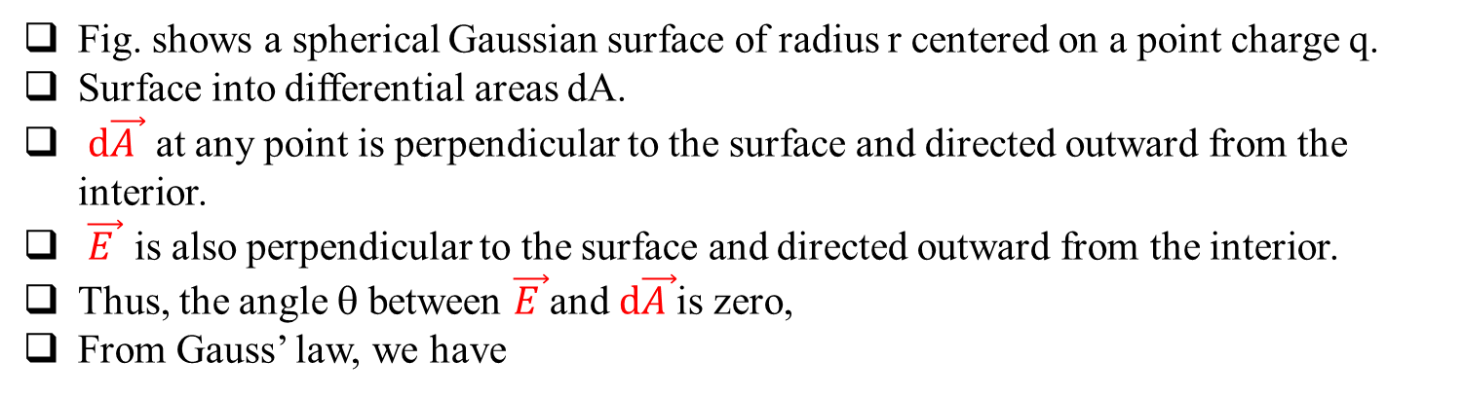
Gauss’ Law and Coulomb’s Law
Fig. shows a spherical Gaussian surface of radius r centered on a point charge q.
Surface into differential areas dA.
$d\vec{A }$ at any point is perpendicular to the surface and directed outward from the interior.
$\vec{E }$ is also perpendicular to the surface and directed outward from the interior.
Thus, the angle θ between $\vec{E }$and $d\vec{A }$is zero,
From Gauss’ law, we have
A spherical Gaussian surface centered on a point charge q.
Since, q_{enc} = q, and E is constant, we have
The integral is now merely the sum of all the differential areas dA on the sphere and thus is just the surface area, 4πr²
Exactly same as the expression for E found using Coulomb’s law

Slide 2
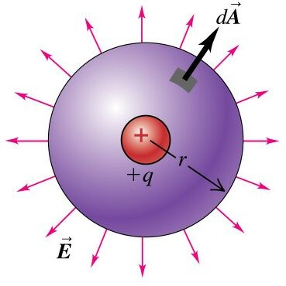
ELECTRIC FLUX OF A POINT CHARGE
What is electric flux that comes from a point charge?

Slide 3
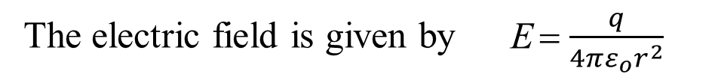
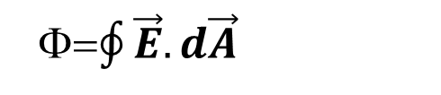
ELECTRIC FLUX OF A POINT CHARGE
What is electric flux that comes from a point charge?
We start from
=Φ $\oint{\vec{E}.d\vec{A}}$
The electric field is given by E = $\frac{q}{4πε_{o}r^{2}}$
The problem has spherical symmetry, we therefore use a sphere as the Gaussian surface
Since E is radial, its dot product with the differential area vector, which is also radial.
Also E is the same at every point on the surface of the sphere

Slide 4
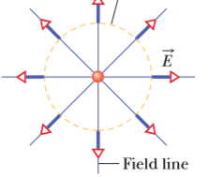
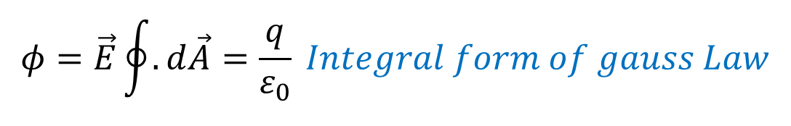
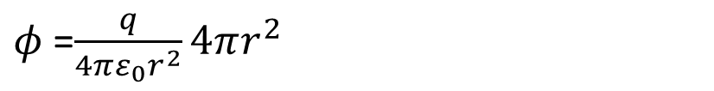
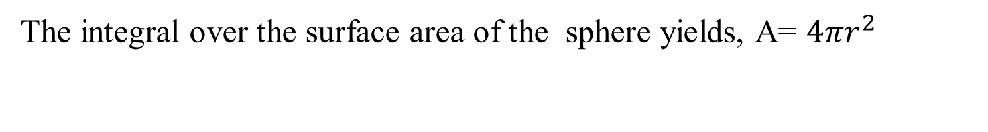
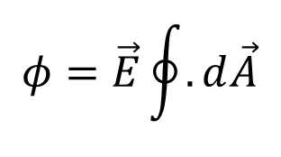
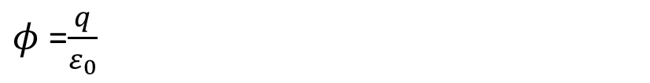
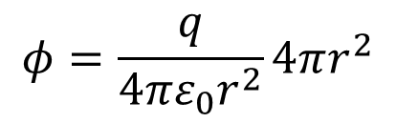
ELECTRIC FLUX OF A POINT CHARGE
$$φ=\vec{E}\oint{.d\vec{A}}$$
For these reasons, E can be pulled out
The integral over the surface area of the sphere yields, A= $4πr^{2}$
$$φ=\frac{q}{4πε_{0}r^{2}}4πr^{2}$$
Gausssian surface
$φ$ =$\frac{q}{4πε_{0}r^{2}}4πr^{2}$
$φ$ =$\frac{q}{ε_{0}}$
$$φ=\vec{E}\oint{.d\vec{A}}=\frac{q}{ε_{0}} Integral form of gauss Law$$
The flux is independent of the radius of the sphere

Slide 5
GAUSSIAN SURFACES
“ Gauss’s Law depends upon symmetry, Only if symmetry exist then we can use Gauss law
Choose surface appropriate to problem
It does not have to be a sphere
Exploit symmetries, if any
Symmetries
Cylindrical Symmetry
Planar Symmetry
Spherical Symmetry

Slide 6
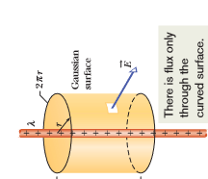
Applying Gauss’ Law: Cylindrical Symmetry
Figure shows a section of an infinitely long cylindrical plastic rod with a uniform charge density .
To find an expression for the electric field magnitude E at radius r from the central axis of the rod, outside the rod.
The charge distribution and the field have cylindrical symmetry.
To find the field at radius r, we enclose a section of the rod with a concentric Gaussian cylinder of radius r and height L.
Now apply Gauss’ law to relate the charge enclosed by the cylinder and the net flux through the cylinder’s surface.
L

Slide 7
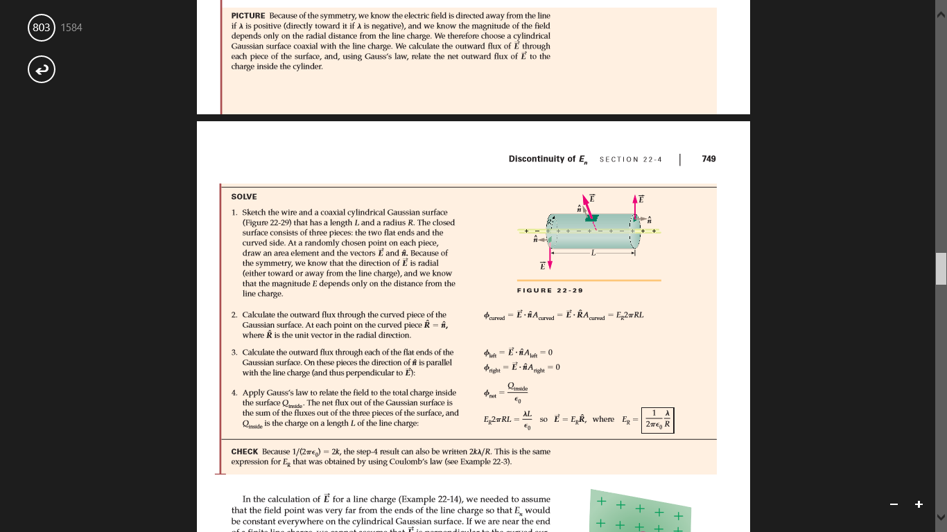
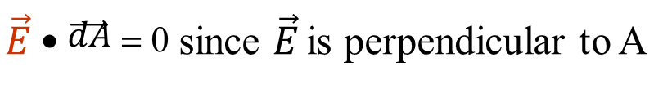
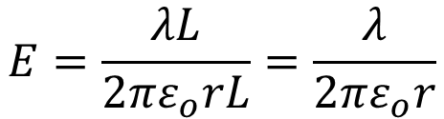
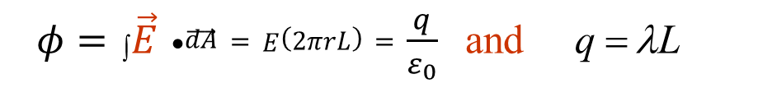
Applying Gauss’ Law: Cylindrical Symmetry
Because of the symmetry, the electric field at any point must be radially outward (the charge is positive). That means that at any point on the end caps,
Apply Gauss’ Law:
On the ends,
$\vec{E}$ • $\vec{\vec{dA}}$ = 0 since $\vec{E}$ is perpendicular to A
To find the flux through the cylinder’s curved surface,
The area vector is radially outward (away from the interior of the Gaussian surface) and thus in the same direction as the field.
The dot product in Gauss’ law is then simply
$φ=$∫ $\vec{E}$ • $\vec{\vec{dA}}=E\left(2πrL\right)=\frac{q}{ε_{0}}$and q = λL
$$E=\frac{λL}{2πε_{o}rL}=\frac{λ}{2πε_{o}r}$$
Equating these and rearranging yields

Slide 8
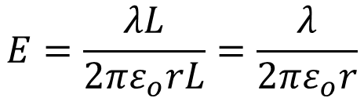
Applying Gauss’ Law: Cylindrical Symmetry
$$E=\frac{λL}{2πε_{o}rL}=\frac{λ}{2πε_{o}r}$$
Electric field due to an infinitely long, straight line of charge, at a point that is a radial distance r from the line.
The direction of is radially outward from the line of charge if the charge is positive, and radially inward if it is negative
If the rod has a uniform volume charge density ρ,
we could use a similar procedure to find the electric field magnitude inside the rod.
We would just shrink the Gaussian cylinder shown in Fig until it is inside the rod.
The charge q_{enc} enclosed by the cylinder would then be proportional to the volume of the rod enclosed by the cylinder because the charge density is uniform.

Slide 9
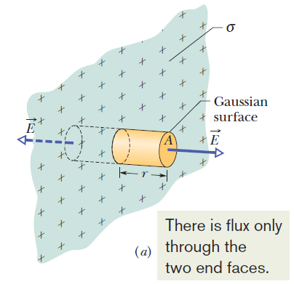
APPLYING GAUSS’ LAW: PLANAR SYMMETRY
Apply Gauss law to derive the electric field magnitude of E near a large, flat, nonconducting surface with a uniform surface charge density
Figure shows a portion of a thin, infinite, nonconducting sheet ( Thin plastic wrap) with a uniform (positive) surface charge density σ .
Let us find the electric field a distance r in front of the sheet.
(b) side view of a portion of a very large, thin plastic sheet, uniformly charged on one side to surface charge density σ. A closed cylindrical Gaussian surface passes through the sheet and is perpendicular to it.

Slide 10
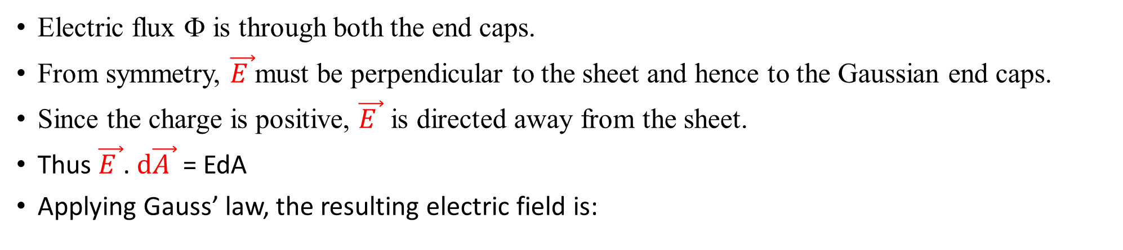
APPLYING GAUSS’ LAW: PLANAR SYMMETRY
Electric flux Φ is through both the end caps.
From symmetry, $\vec{E }$must be perpendicular to the sheet and hence to the Gaussian end caps.
Since the charge is positive, $\vec{E }$ is directed away from the sheet.
Thus $\vec{E }$. $d\vec{A }$ = EdA
Applying Gauss’ law, the resulting electric field is:
Nonconducting Sheet of Charge

Slide 11
APPLYING GAUSS’ LAW: PLANAR SYMMETRY
Conducting Sheet of Charge
The external electric field just outside the surface of an isolated charged conductor with surface charge density σ is perpendicular to the surface and has magnitude
(external, charged conductor).
Inside the conductor, the electric field is zero.
_{E =} σ
ε ₀

Slide 12
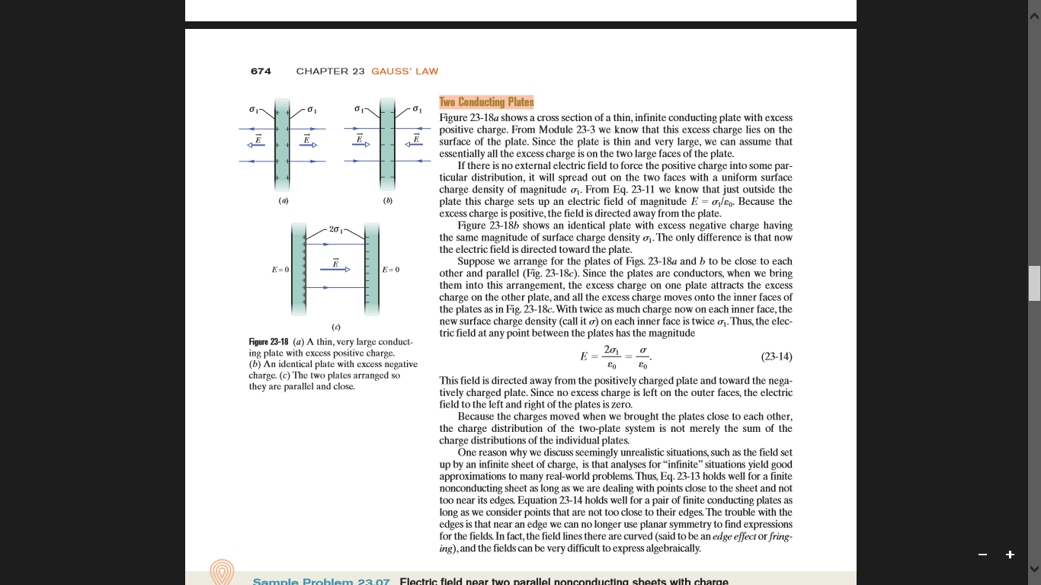
APPLYING GAUSS’ LAW: PLANAR SYMMETRY
Two Conducting Plates
Figure shows a cross section of a thin, infinite conducting plate with excess positive charge.
This excess charge lies on the surface of the plate. Since the plate is thin and very large,
Assume that all the excess charge is on the two large faces of the plate.

Slide 13
APPLYING GAUSS’ LAW: PLANAR SYMMETRY
If there is no external electric field to force the positive charge into some particular distribution, it will spread out on the two faces with a uniform surface charge density of magnitude σ₁.
From Fig we know that just outside the plate this charge sets up an electric field of magnitude E = σ ₁/ε ₀
.Because the excess charge is positive, the field is directed away from the plate.
Figure b shows an identical plate with excess negative charge having the same magnitude of surface charge density σ ₁ .
The only difference is that now the electric field is directed toward the plate.

Slide 14
APPLYING GAUSS’ LAW: PLANAR SYMMETRY
Suppose a and b to be close to each other and parallel (Fig. c).
Since the plates are conductors, the excess charge on one plate attracts the excess charge on the other plate, and all the excess charge moves onto the inner faces of the plates Fig.c.
With twice as much charge now on each inner face,
the new surface charge density on each inner face is twice σ 1
.
Thus, the electric field at any point between the plates
has the magnitude
This field is directed away from the positively charged plate and
toward the negatively charged plate.
Since no excess charge is left on the outer faces, the electric field to the left and right of the plates is zero.

Slide 15
APPLYING GAUSS’ LAW: PLANAR SYMMETRY
One reason why we discuss seemingly unrealistic situations, such as the field set up by an infinite sheet of charge, is that analyses for “infinite”situations yield good approximations to many real-world problems.
Thus, Equation holds well for a finite nonconducting sheet as long as we are dealing with points close to the sheet and not too near its edges.
Equation holds well for a pair of finite conducting plates as long as we consider points that are not too close to their edges.
The trouble with the edges is that near an edge we can no longer use planar symmetry to find expressions for the fields.
In fact, the field lines there are curved (said to bean edge effect or fringing),and the fields can be very difficult to express algebraically.

Slide 16
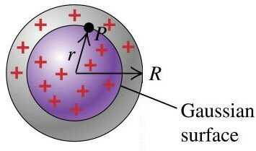
Solid uniformly charged sphere
APPLYING GAUSS’ LAW: SPHERICAL SYMMETRY
Calculate the electric field at point p at distance r form the center of the sphere produced by solid sphere of radius R with uniform distribution of charges

Slide 17
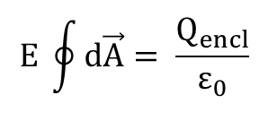
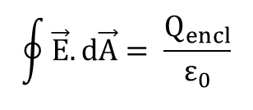

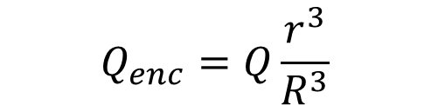
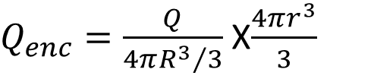



APPLYING GAUSS’ LAW: SDPHERICAL SYMMETRY
Electric Field is everywhere perpendicular to surface, i.e. parallel to surface normal
Gauss’ Law then gives
$$\oint{\vec{E}.d\vec{A}= \frac{Q_{encl}}{ε_{0}}}$$
$$E \oint{d\vec{A}= \frac{Q_{encl}}{ε_{0}}}$$
Charge Density
$$ρ=\frac{Q_{enc}}{{4πR^{3}}/3}$$
$$E\text{4}\text{π} r^{2}=\frac{{Qr}^{3}}{ε_{0}R^{3}}$$
$$Q_{enc}=ρV$$
Here A is the area of Gaussian sphere,
$$E =\frac{Qr}{{\text{4}\text{π}ε}_{0}R^{3}}$$
$Q_{enc}=\frac{Q}{{4πR^{3}}/3}$ X$\frac{4πr^{3}}{3}$
$$Q_{enc}=Q\frac{r^{3}}{R^{3}}$$

Slide 18
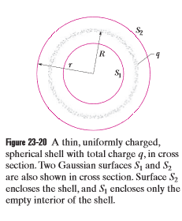
APPLYING GAUSS’ LAW: SPHERICAL SYMMETRY
Figure shows a charged spherical shell of total charge q and radius R and two concentric spherical Gaussian surfaces, S1 and S2.
Applying Gauss’ law to surface S1,for which r< R,leads directly to
E = 0 (spherical shell,field at r<R)
Because this Gaussian surface encloses no charge
We apply Gauss’ law to surface S2, for which r > R,we would find that

Slide 19
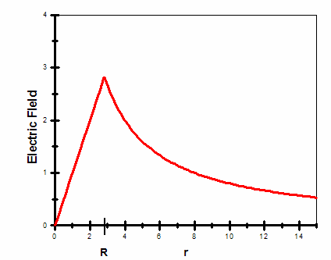
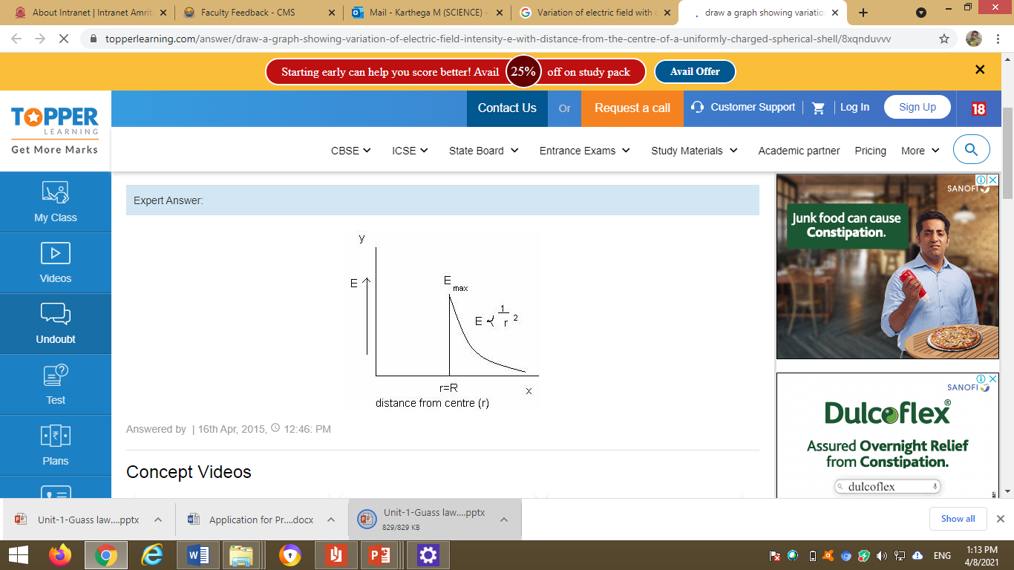
Variation of electric field with distance
(a) uniformly charged solid sphere
(b) Spherical shell

Slide 20
APPLICATION OF GAUSS LAW IN A CONDUCTOR

Slide 21
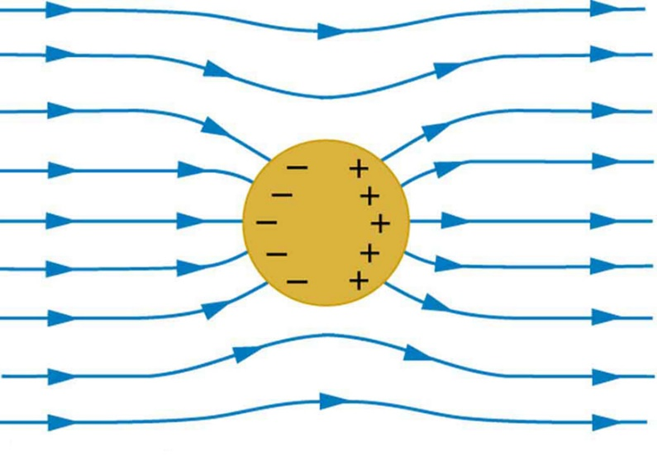
Conductors in Electrostatic Equilibrium
Electrostatic equilibrium means there is no net motion of the charges inside the conductor.
The electric field inside must be zero.
If this were not the case, charges would move.

Slide 22
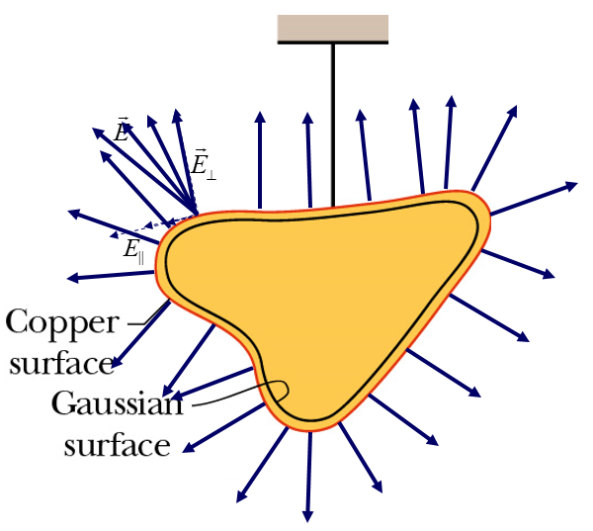
A Charged Isolated Conductor
To understand the behavior of electric fields inside the conductors through Gauss’s Law
If an excess charge is placed on an isolated conductor, that amount of charge will move entirely to the surface of the conductor.
None of the excess charge will be found within the body of the conductor.
The electric field inside this conductor must be zero.
Field At the Surface of a Conductor
Imagine an electric field at some arbitrary angle at the surface of a conductor.
There is a component perpendicular to the surface, so charges will move in this direction until they reach the surface, and then, since they cannot leave the surface, they stop.
There is also a component parallel to the surface, so there will be forces on charges in this direction.
Since they are free to move, they will move to nullify any parallel component of E.
In a very short time, only the perpendicular component is left.

Slide 23
Field Inside a Conductor
Apply Gauss’ Law to show that there is no net charge inside the conductor of charge q.
Take an arbitrarily shaped conductor, and draw a Gaussian surface just inside.
Physically, we expect that there is no electric field inside, since otherwise the charges would move to nullify it.
Since the excess charge is not inside the Gaussian surface, E = 0 everywhere inside, E must be zero also on the Gaussian surface, hence there can be no net charge inside.
Hence, all of the charge must be on the surface.
If we make a cavity in the conductor, and draw a Gaussian surface surrounding the cavity. There is no E field through this new surface, hence there is no net charge in the cavity.
Since the excess charge remains on the outer surface of the conductor
(a) A lump of copper with a charge q hangs from an insulating thread. A Gaussian surface is placed within the metal, just inside the actual surface.
(b) The lump of copper now has a cavity within it. A Gaussian surface lies within the metal, close to the cavity surface.

Slide 24
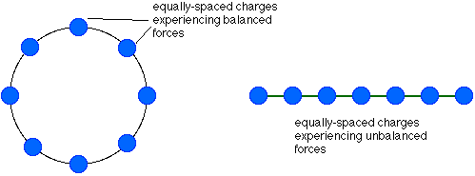

Nature of Charge Distribution on Conductors
Charges placed on a conducting sphere, spread themselves evenly around the surface.
For other shapes, however, the charges tend to collect near sharp curvature.
charges collect near tip
conductor
To understand this, consider a line of charge.
balanced forces
unbalanced forces
(pushed on by one charge
from left, but by 5 charges
from right)
redistributed charges
(pushed on by one nearby charge from left,
but by 5 more distant charges from right)

